Slide 1
Issa’s events
Onboarding/Offboarding Progress and Milestones

Slide 2
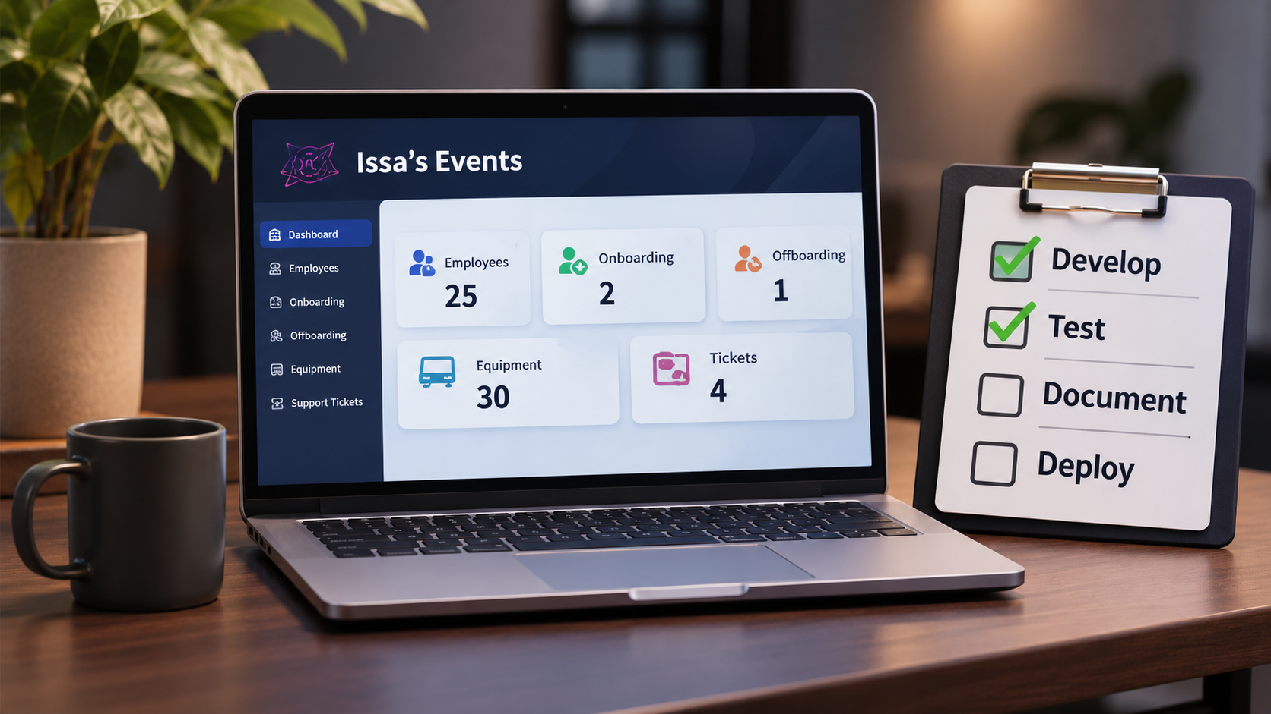
Phase 3 – Milestone progress
Development Area | Status
User Authentication & Roles | In Progress
Employee Management | In Progress
Onboarding Workflow | In Progress
Offboarding Workflow | In Progress
Equipment Inventory | To Verify
Dashboard | In Progress
Help Desk | In Progress
Testing & Documentation | Behind Schedule

